Slide 1

Connecting to a Cloud-Hosted DSpace Instance (Version 1.8.2) and Testing new features in Dpace 3.0 Demo. Presented by: Andrew Mwesigwa Lib@web 2012 Participant Librarian I Academic, Makerere Univesity Email: amwesigwa@mulib.mak.ac.ug
Part A: An alternative to hosting DSpace server in-house (where there is no skilled IT staff to manage DSpace server). “DSpace is free but your time is not free”
Part B: What is new in DSpace version 3.0?

Slide 2
Part A: Connecting to cloud-hosted DSpace
Methodology
Create an Amazon Web Service Account
Connect to the pre-installed DSpace instance on Amazon’s cloud market website

Slide 3
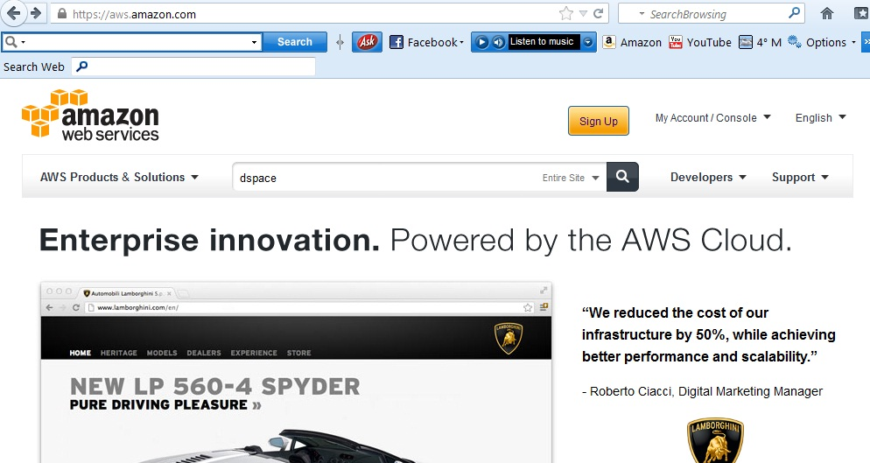
Log onto the Amazon Web Services Website

Slide 4
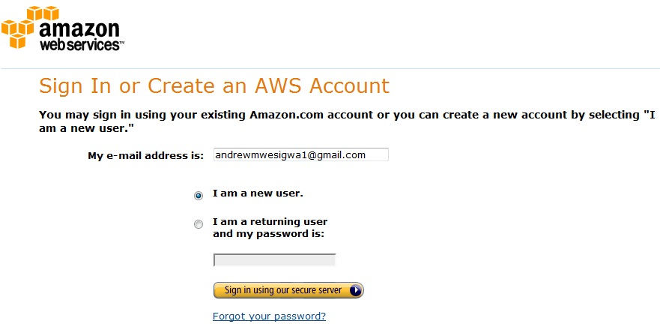
Create an account

Slide 5
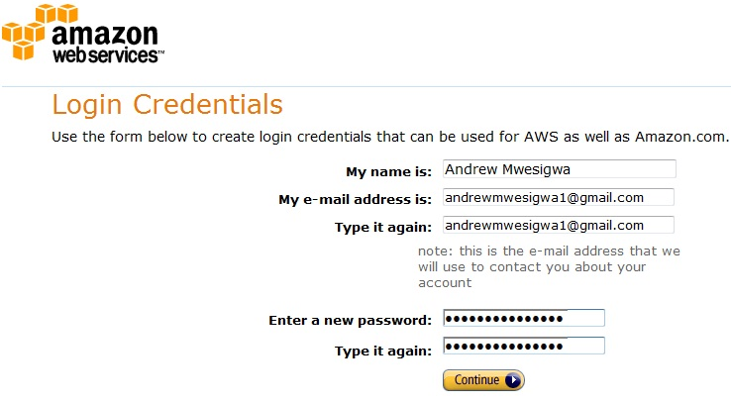
Continue sign-up

Slide 6
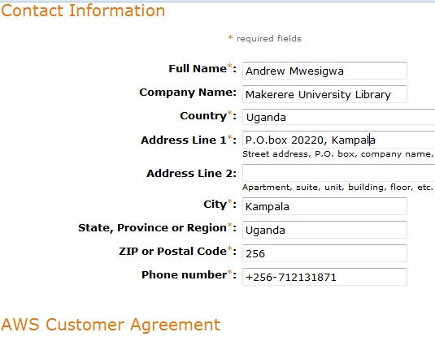
Continue sign-up

Slide 7
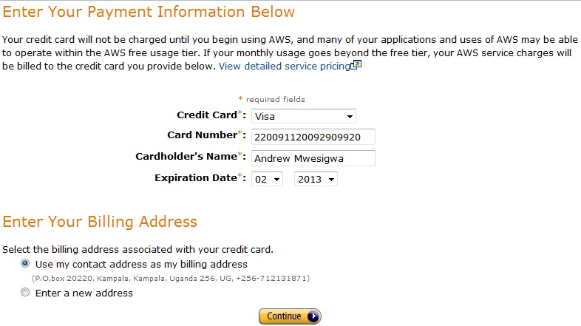
Billing information

Slide 8
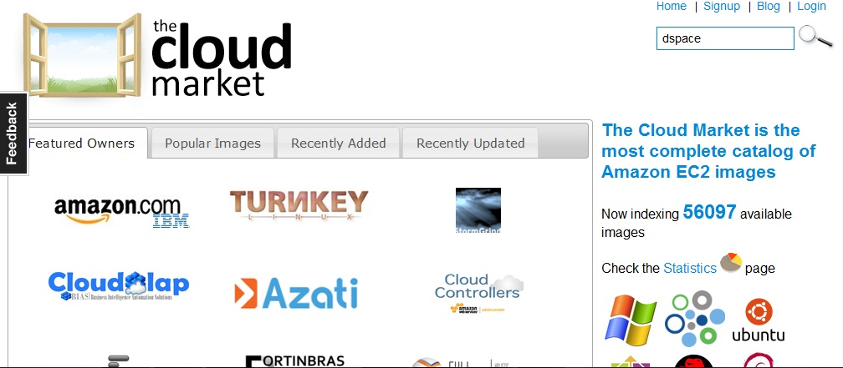
Open AWS cloud market website and search for dspace instance

Slide 9
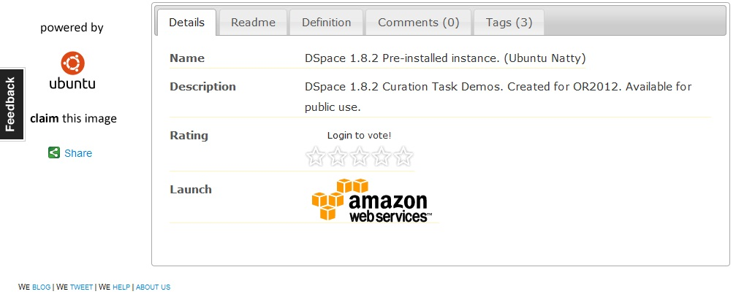
Launch the DSpace instance

Slide 10
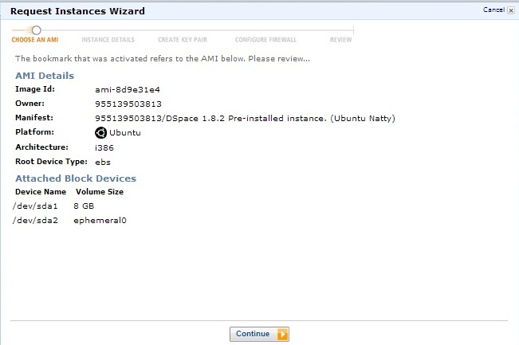
Continue the launch process

Slide 11
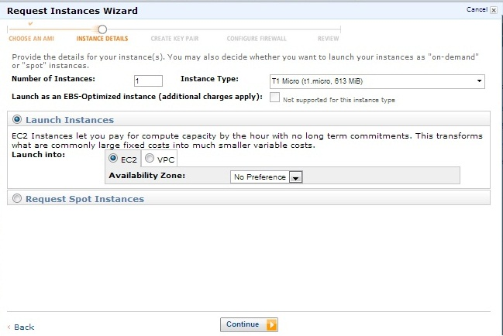
Make sure to select the free tier type instance, otherwise you will need to pay for a more robust service

Slide 12
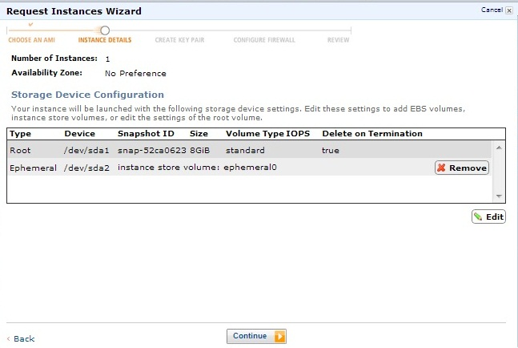
Continue launch process

Slide 13
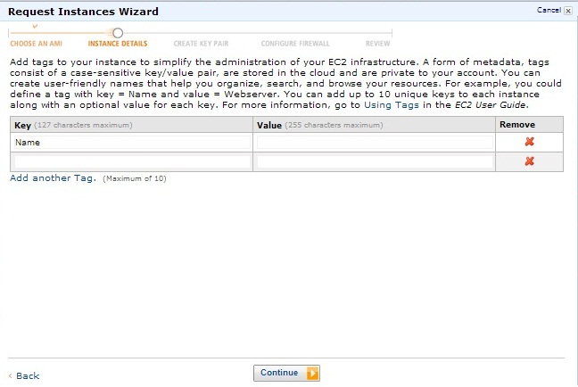
Continue

Slide 14
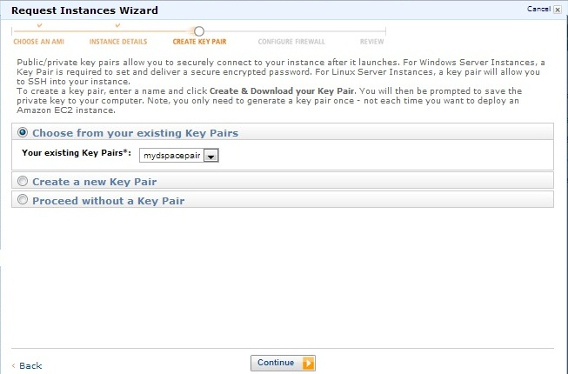
Create a key pair which will link to your DSpace instance

Slide 15
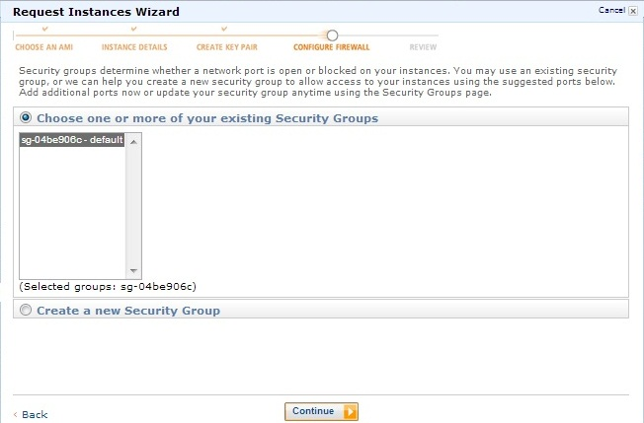
Choose a security group

Slide 16
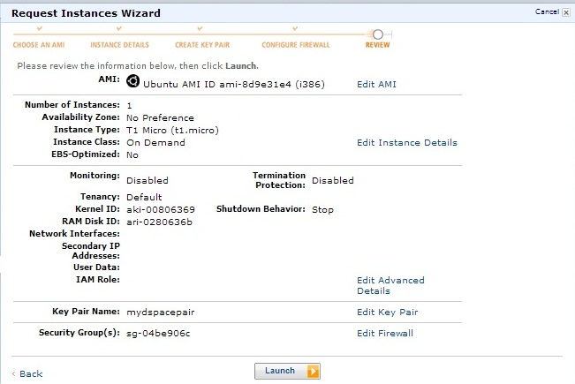
Review settings before launch

Slide 17
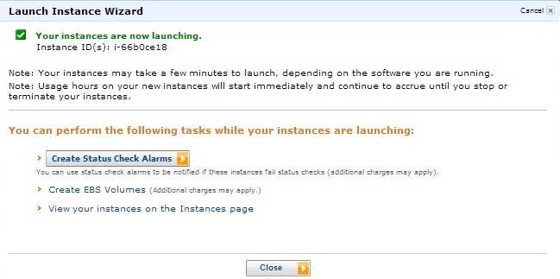
Launched Dspace instance (server starting-up) chose close

Slide 18
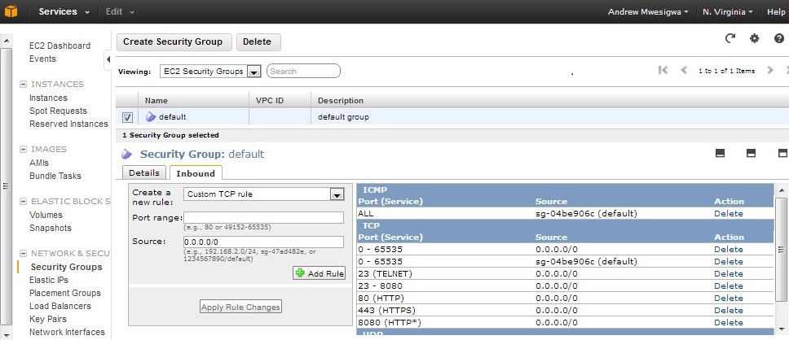
Visit Security group page, select default security group and the Inbound tab. Enable ports 80, 8080

Slide 19
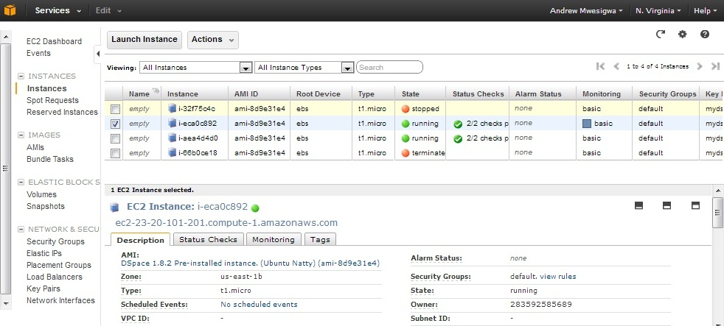
Select a running instance to reveal its URL

Slide 20
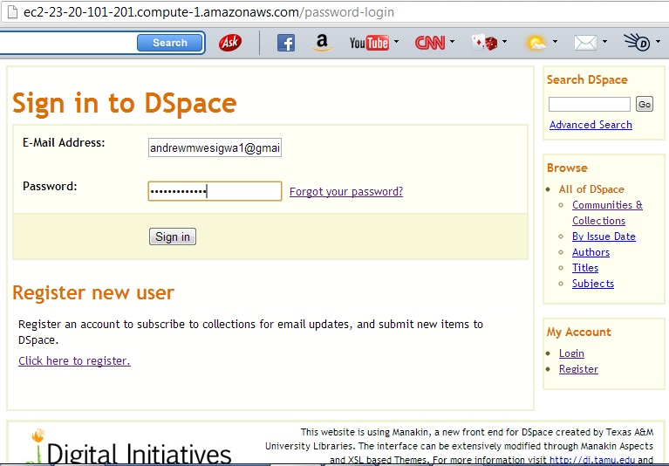
Log into DSpace

Slide 21
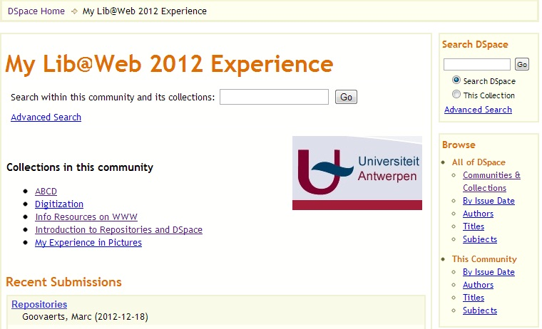
Create communities and collections

Slide 22
Part B: What is new in DSpace 3.0?
One of the identified enhancements is the addition of the creative commons license option at the end of the submission process

Slide 23
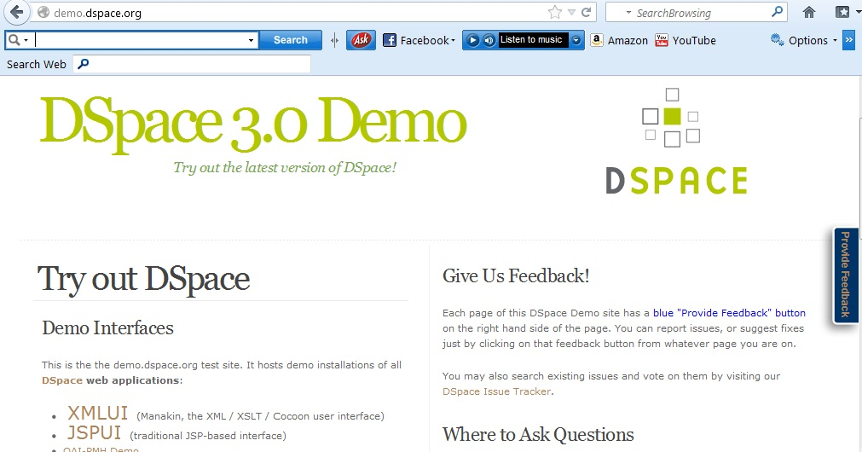
Methodology: Log onto the DSpace demo website and choose either the XMLUI or JSPUI interface option. Login using the provided credentials

Slide 24
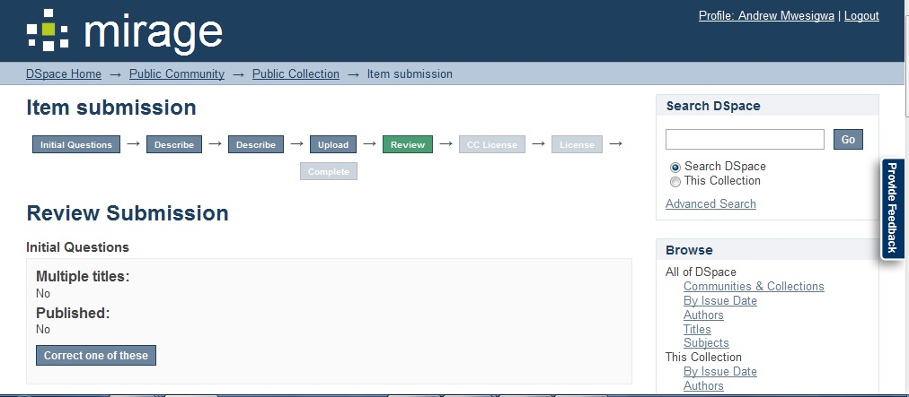
Make a submission

Slide 25
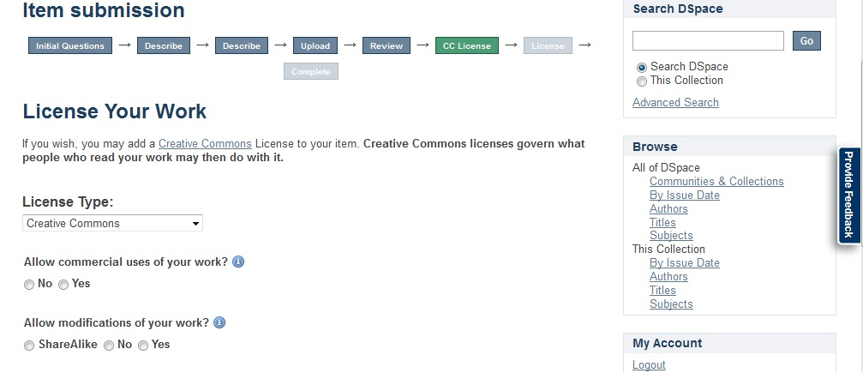
Choose the creative commons license during submission to see how it works

Slide 26
Conclusions
Cost-benefit analysis for cloud service
Sustainability of cloud-hosted
Advise for regular back-up of the repository in the cloud by exporting collections
Evaluate new DSpace versions before you customize your own DSpace instance
Be active and suggest features to the DSpace community
Maklib to evaluate cloud hosted DSpace and utilize DSpace demo site to evaluate new features

Slide 27

Thank you for your attention

