Slide 1

Guidelines for Uploading Theses, Dissertations and/or Project Reports in the Postgraduate Repository
(Mak IR)
http://makir.mak.ac.ug

Slide 2
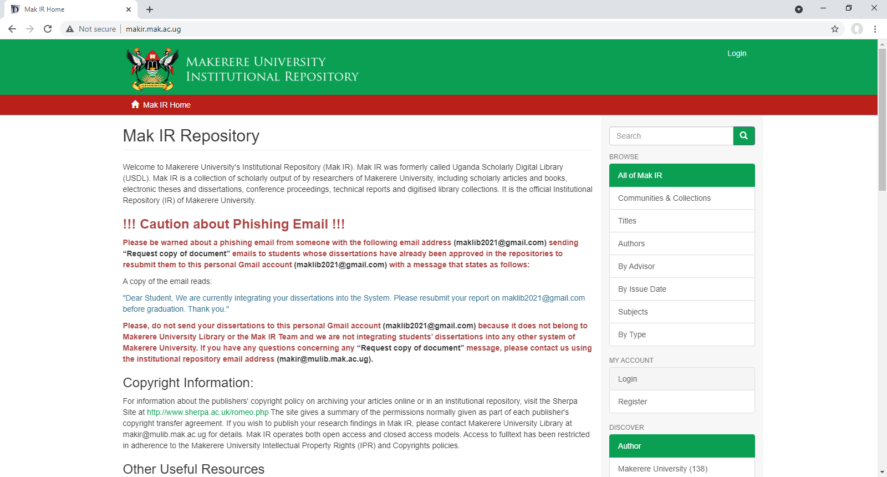
http://makir.mak.ac.ug
To submit your thesis/dissertation/project report, you should have Registered, Requested for, and been Granted Submission Rights by your College/School librarian or via makir.mulib@mak.ac.ug
Click Login to start the submission process

Slide 3
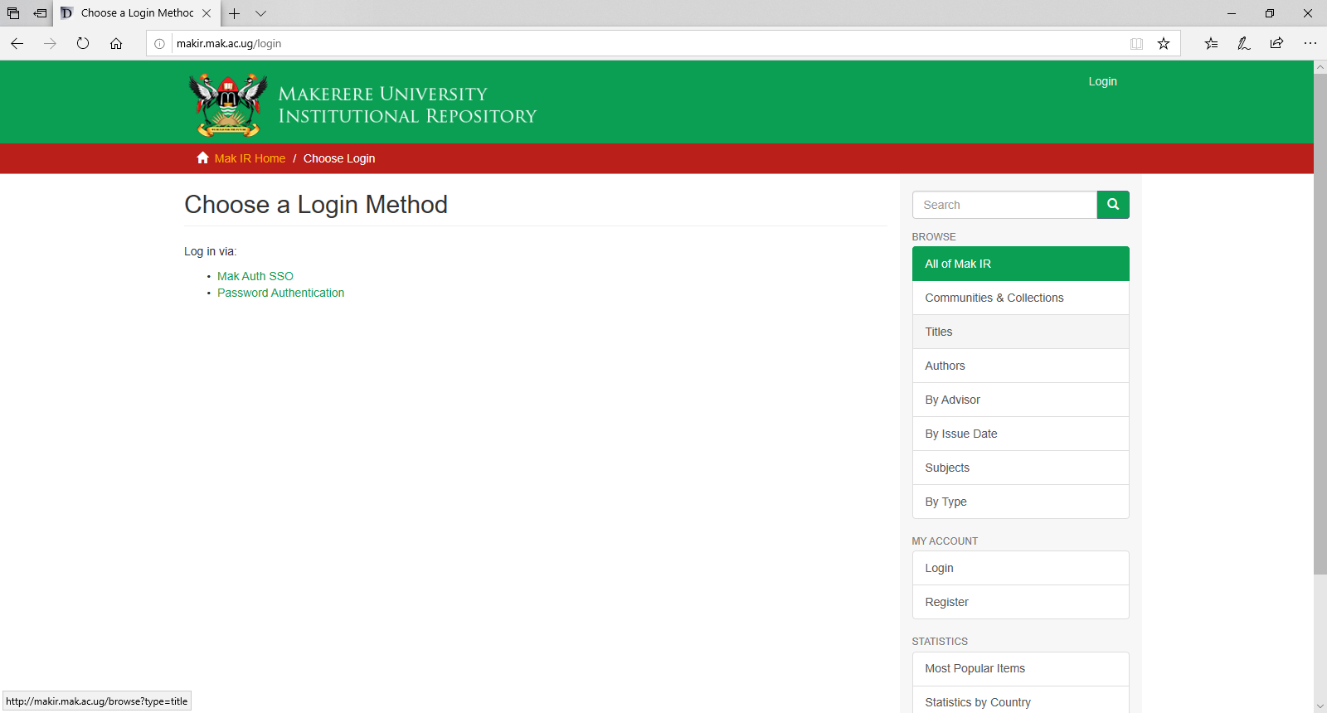
Select Password Authentication

Slide 4
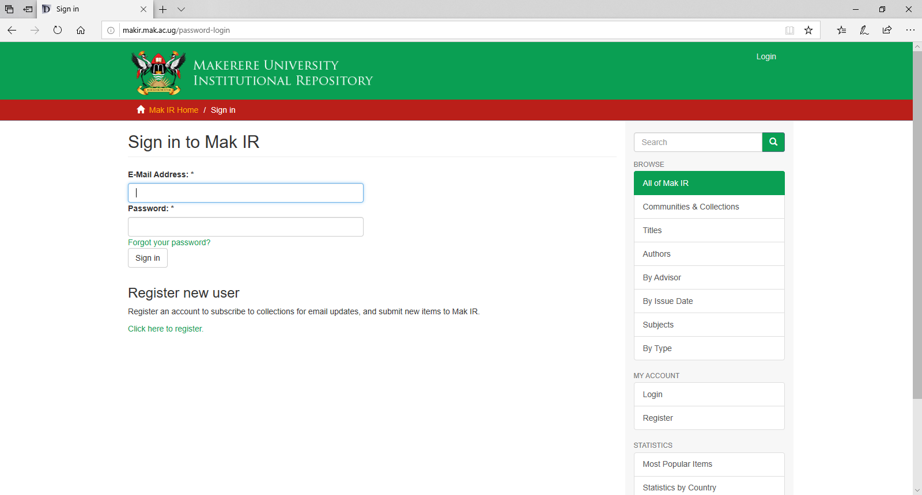
Type your email & password in these text-boxes
Then click Sign in

Slide 5
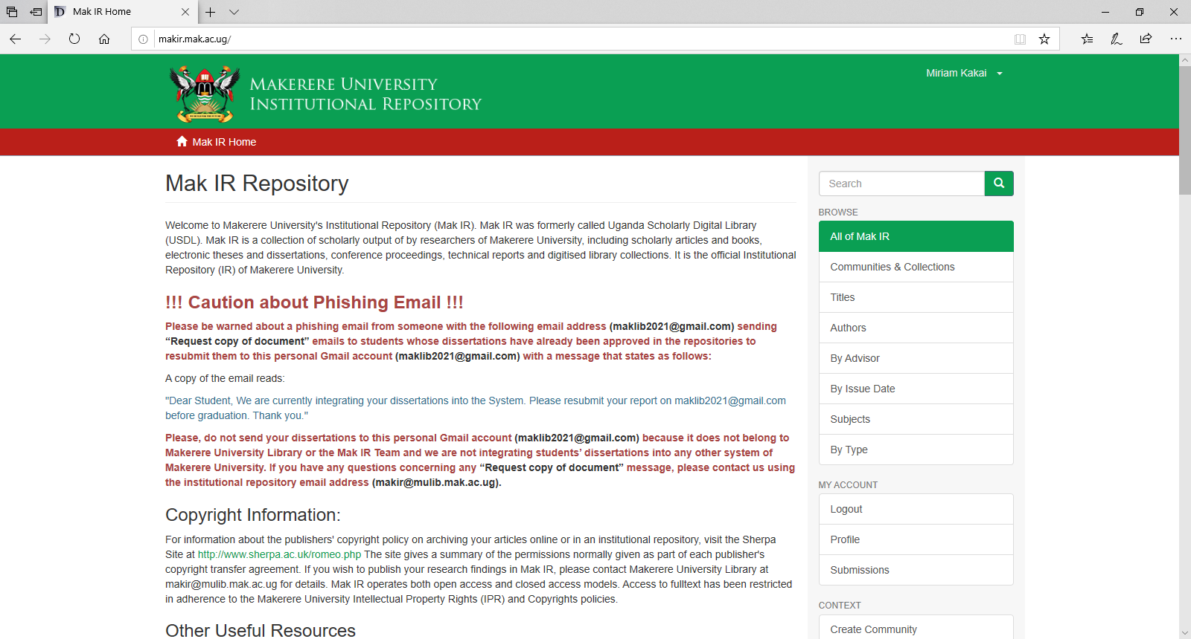
Once you are Logged in,
You should be able to see the Submissions link under My Account
Click the Submissions link to start the process of uploading your dissertation/project report

Slide 6
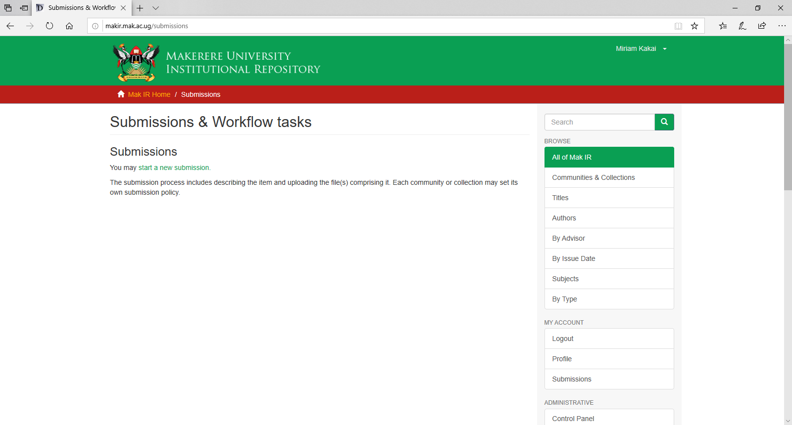
Click start a new submission to proceed

Slide 7
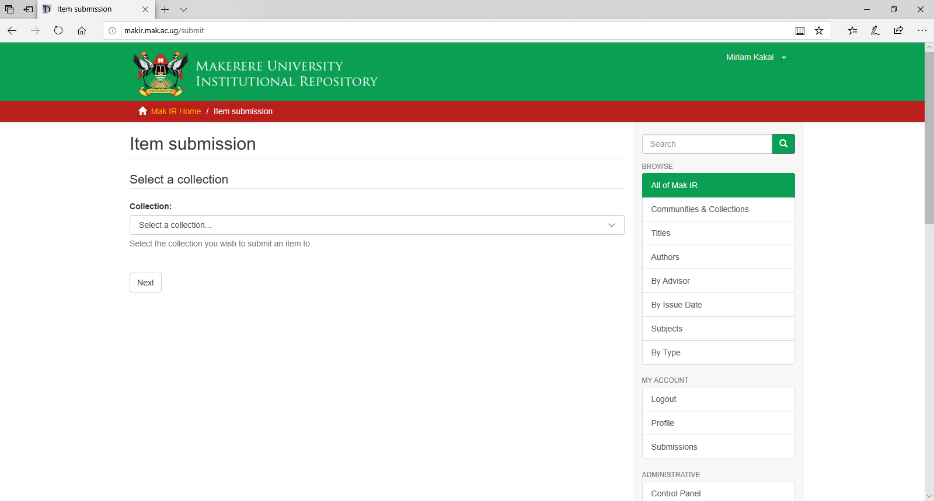
Click this drop down menu and select your school collection (only if you have been Granted Submission Rights).
If there is no collection shown, consult your College/School Librarian or send an email to makir.mulib@mak.ac.ug for submission rights). Include your Name, Registration number, Department, School & College in the email message.

Slide 8
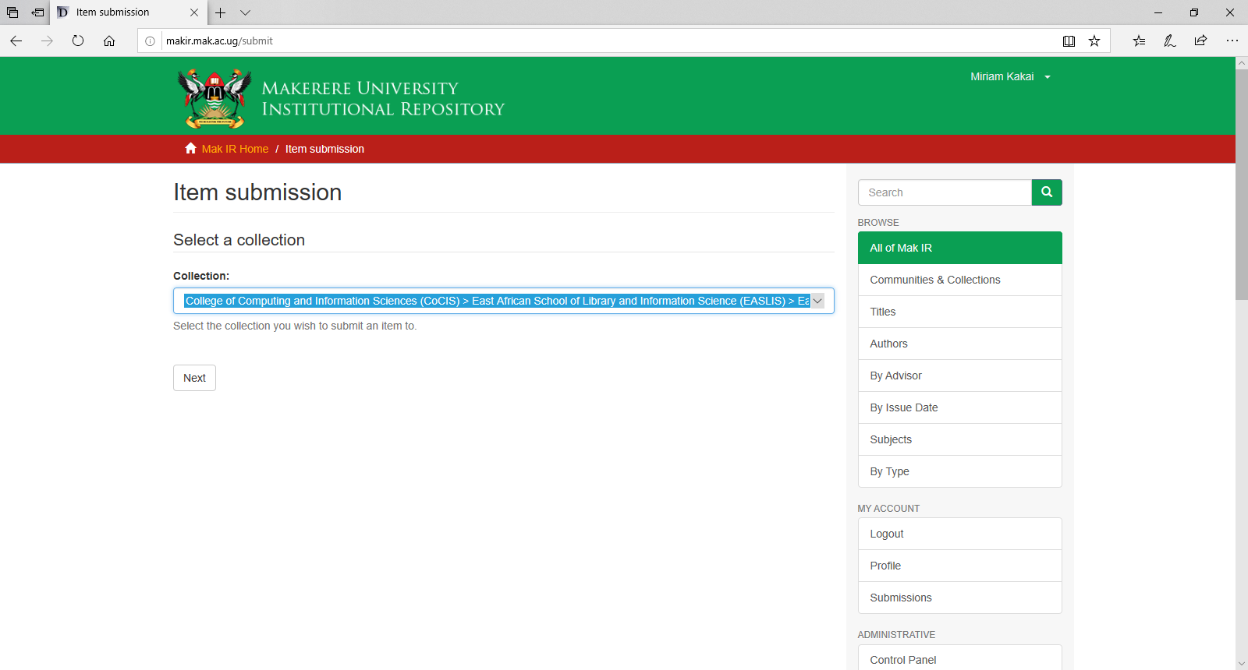
After selecting your school collection
Click the Next button to proceed

Slide 9
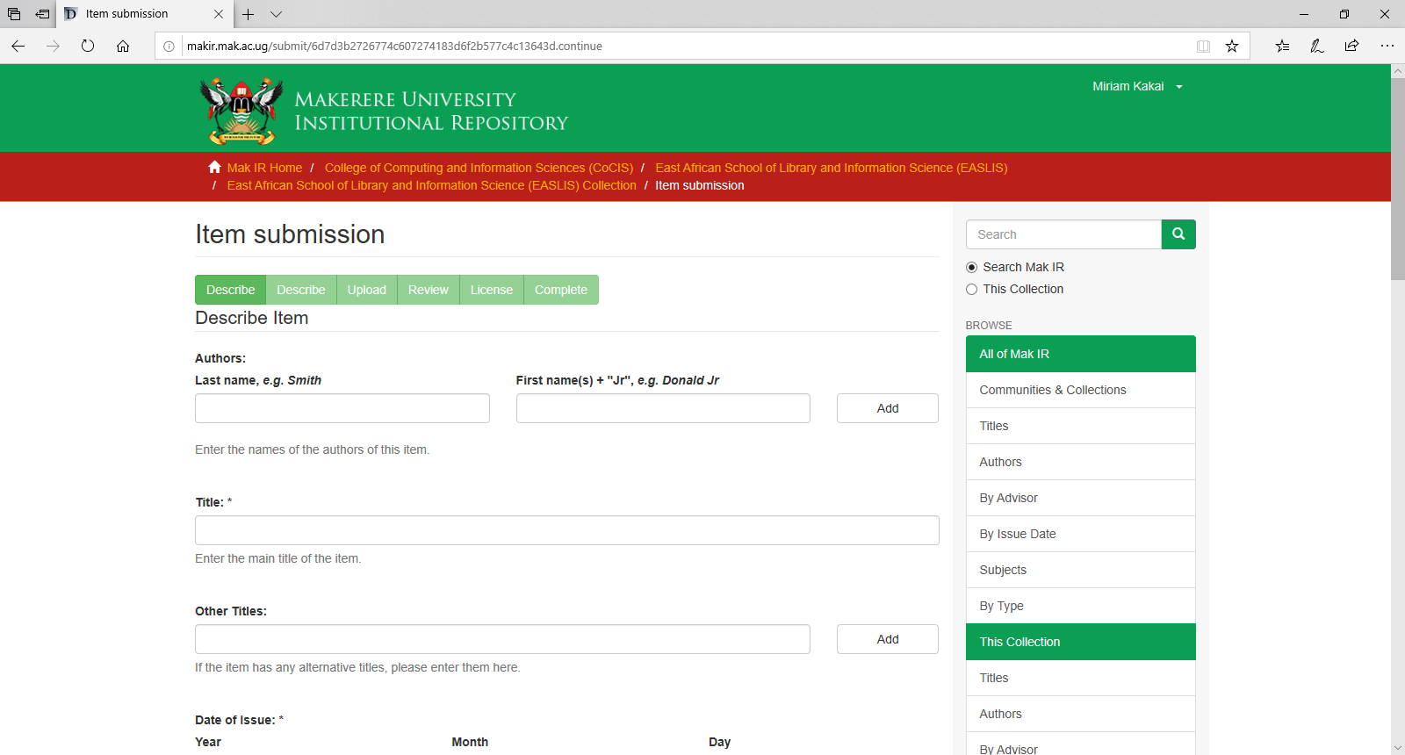
Use the Add button only when there are more than one authors
Type your Surname here starting with a capital letter
Type your Other Names here starting each name with a capital letter
Type the Title of your thesis/dissertation/project report here. Type it in sentence case (i.e. Start the sentence with a capital letter and the rest of the letters in lowercase). Do not type the whole sentence in capital letters.

Slide 10
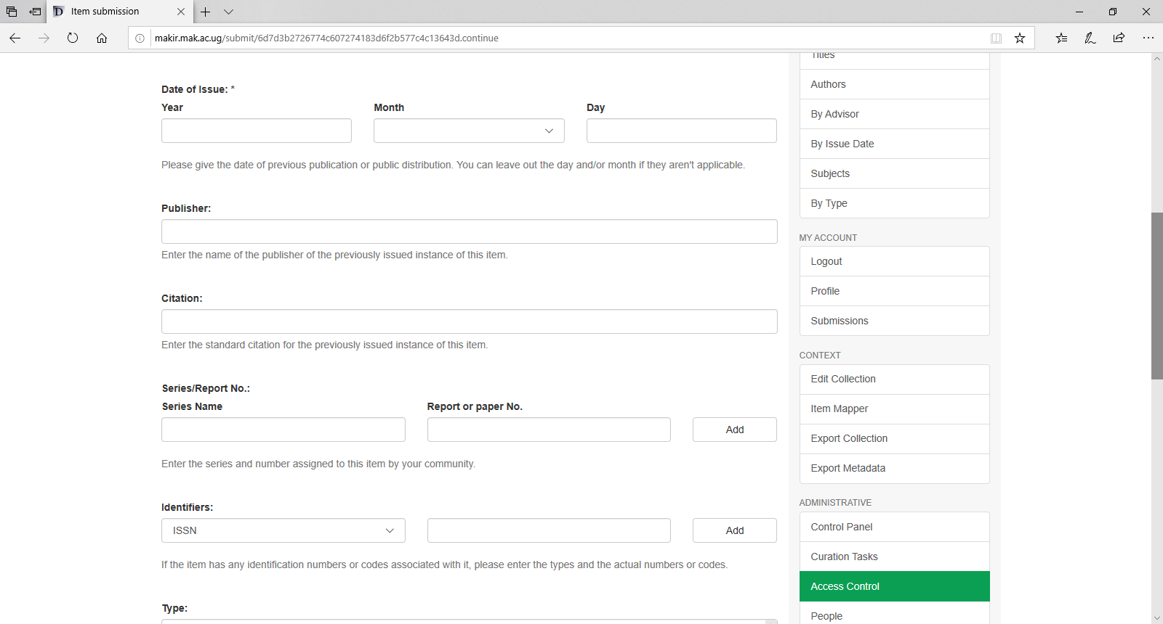
Type the Year & Month that appear on the title page of your thesis/dissertation/project report here
The Publisher is Makerere University
Type the Citation as follows:
Surname, Abbreviate Other Names. (Year). Title (Unpublished PhD/master’s/PGD dissertation). Makerere University, Kampala, Uganda.
Citation Example:
Kakai, M. (2021). Guidelines for uploading theses, dissertations and project reports in the postgraduate repository (Mak IR) (Unpublished master’s dissertation). Makerere University, Kampala, Uganda.

Slide 11
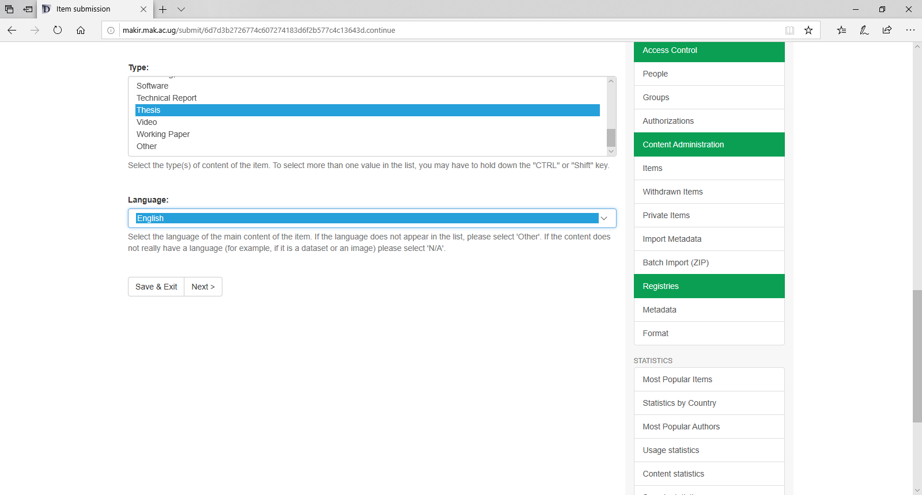
Scroll down and select Thesis as the Type of work being uploaded/submitted.
Click this drop down menu and select English (as the language used in the dissertation, otherwise, select any other appropriate option).
Click the Next button to proceed.

Slide 12
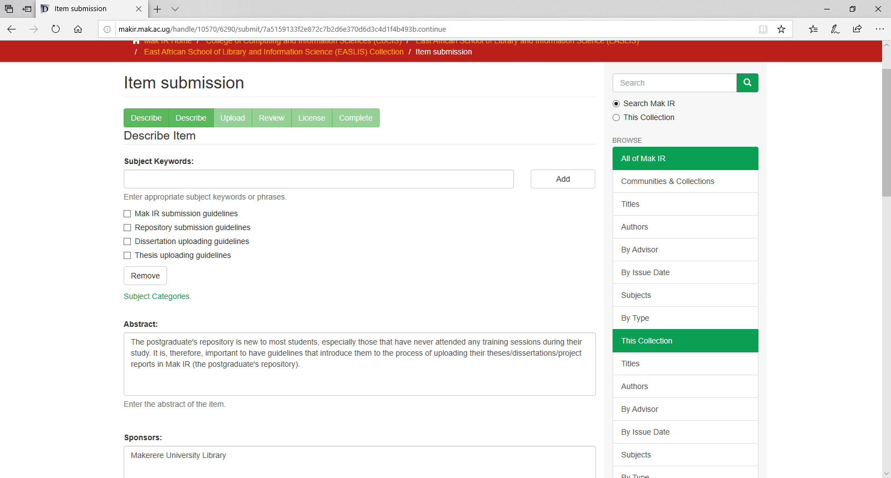
Use the Add button only when there are more than one keywords
Type each keyword as an independent phrase
Copy the Abstract from your Microsoft Word document and paste it here. Avoid copying the abstract from your PDF document because it gets distorted and affects the display of the abstract.

Slide 13
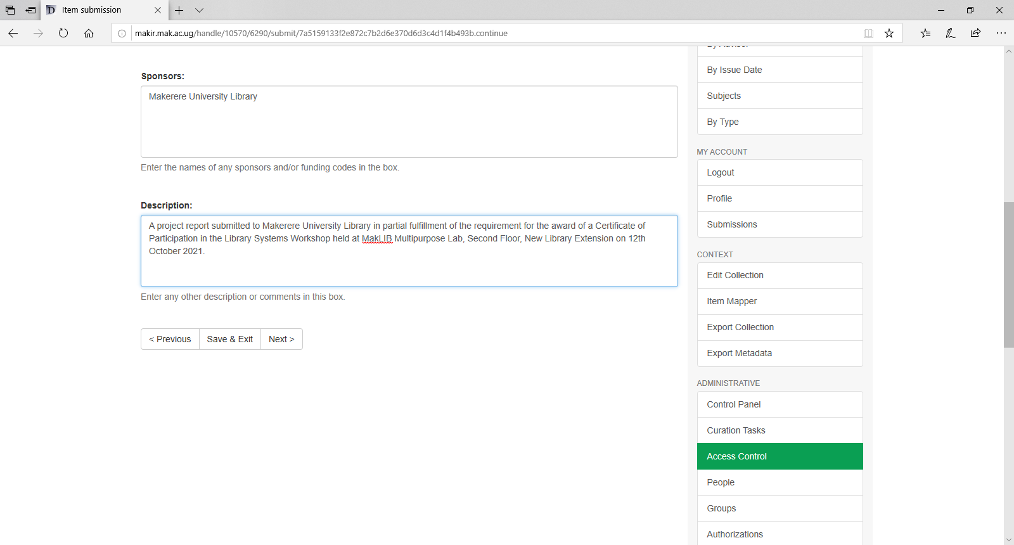
Insert a Sponsor only if it is an organisation
The Description required below is extracted from the title page of your thesis / dissertation / project report. Type it in Sentence case except for the Names of the School, Degree & University):
Example of Description:
A project report submitted to the East African School of Library and Information Science in partial fulfilment of the requirement for the award of a Master’s Degree in Information Science of Makerere University.
Click the Next button to proceed.

Slide 14
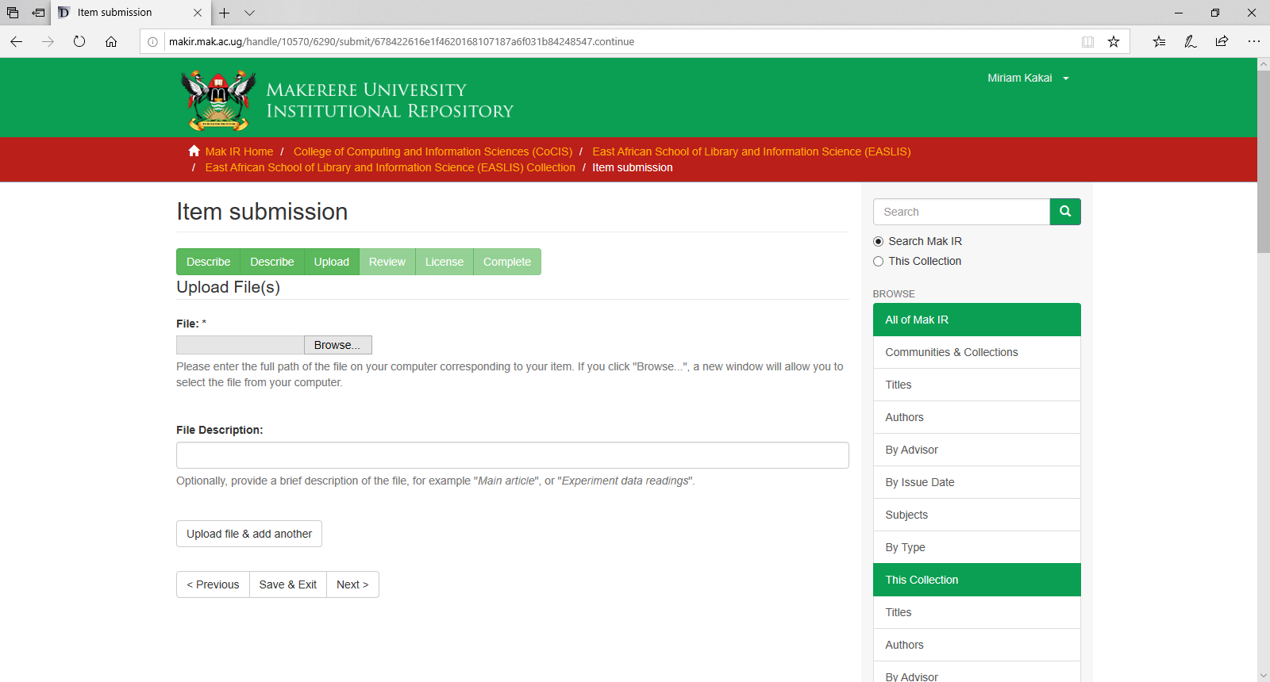
Browse for the PDF document of your dissertation & upload it here. The PDF document that contains the signed declaration & approval pages should be named as follows: Surname-CollegeAbbreviation-CourseAbbreviation
Example: Kakai-CoCIS-Master’s
The File Description here is either:
PhD Thesis or PhD Dissertation or Master’s Dissertation or Master’s Project Report or Postgraduate Diploma
Click the Next button to proceed.

Slide 15
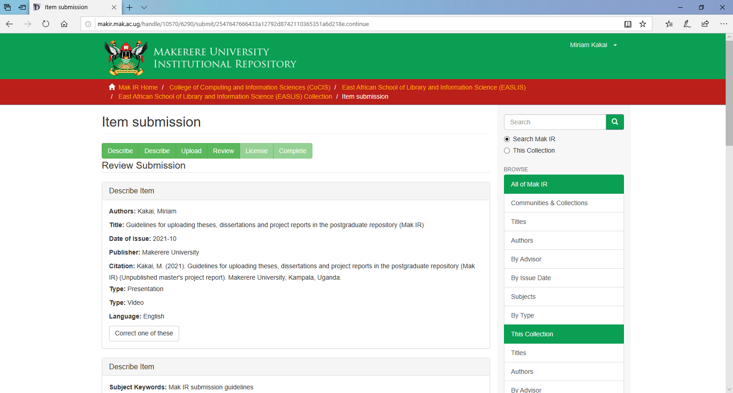
This is a display & Review of everything that you have submitted so far.
Read through & select the Correct one of these buttons found at the bottom of each section if you identify an error that needs to be corrected.

Slide 16
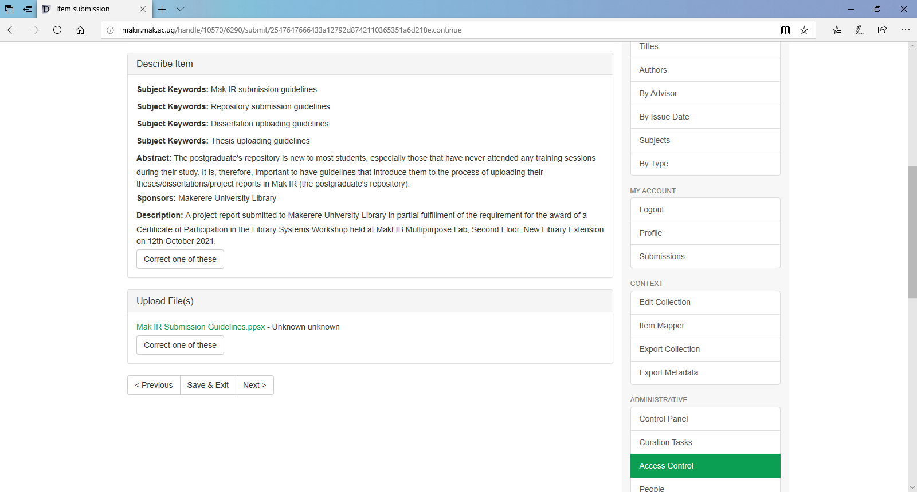
This is a continuation of the previous page.
Click the Next button to proceed.

Slide 17
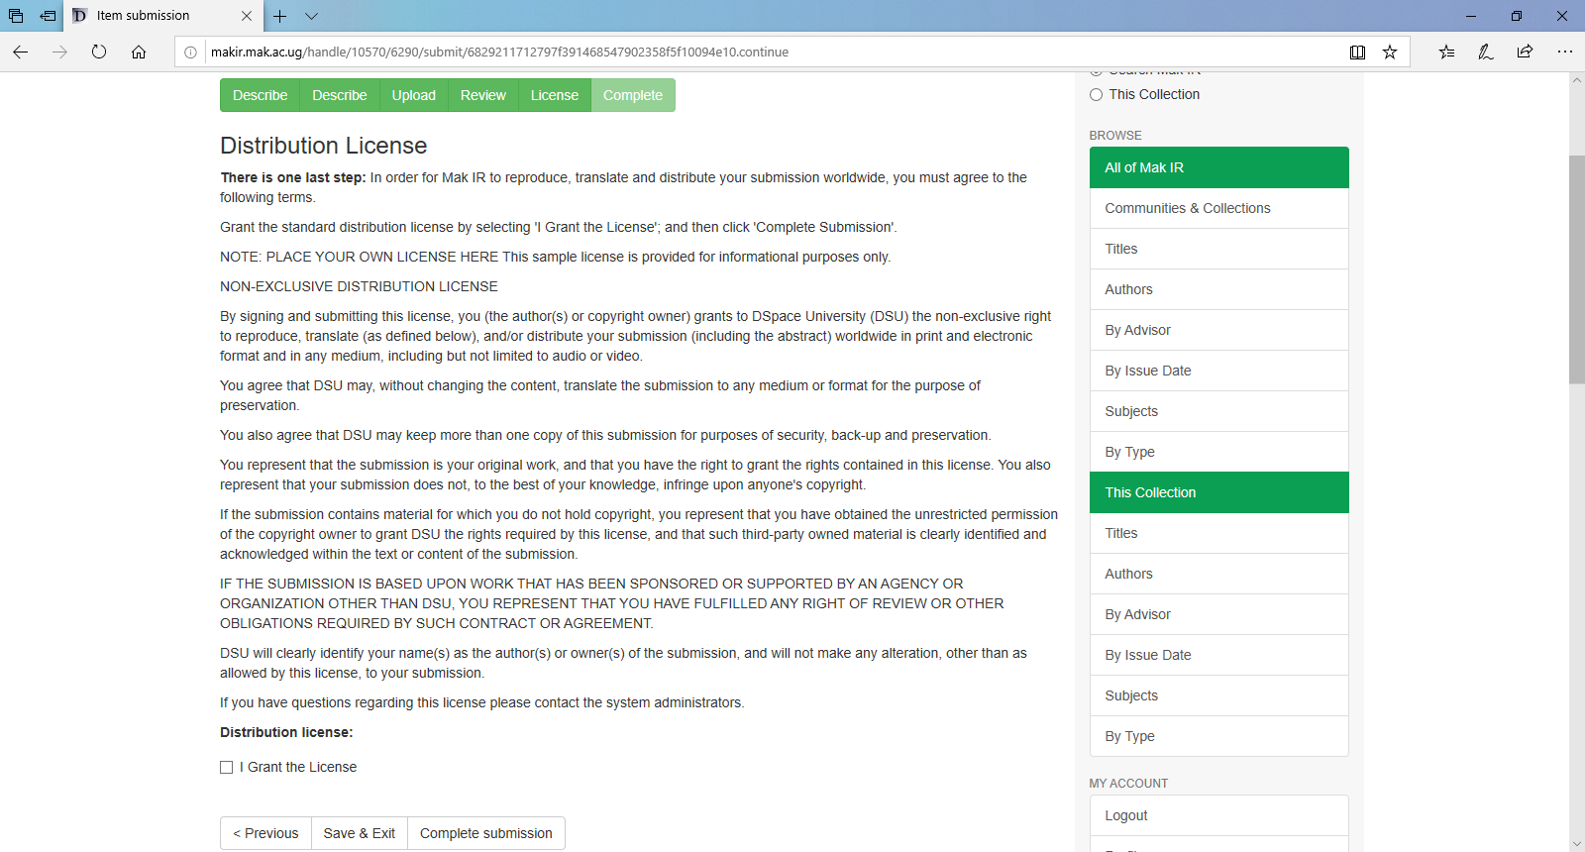
Tick the I Grant the License button & then click the Complete submission button to proceed.

Slide 18
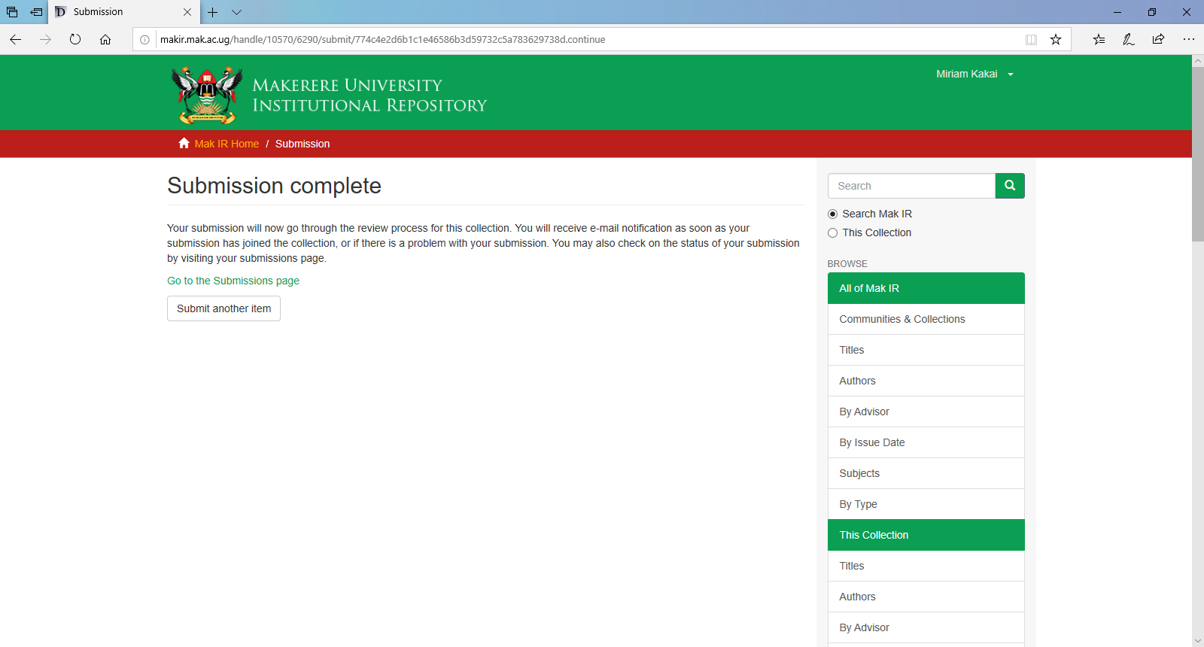
Go to the Submissions page to check the status of your submission.

Slide 19
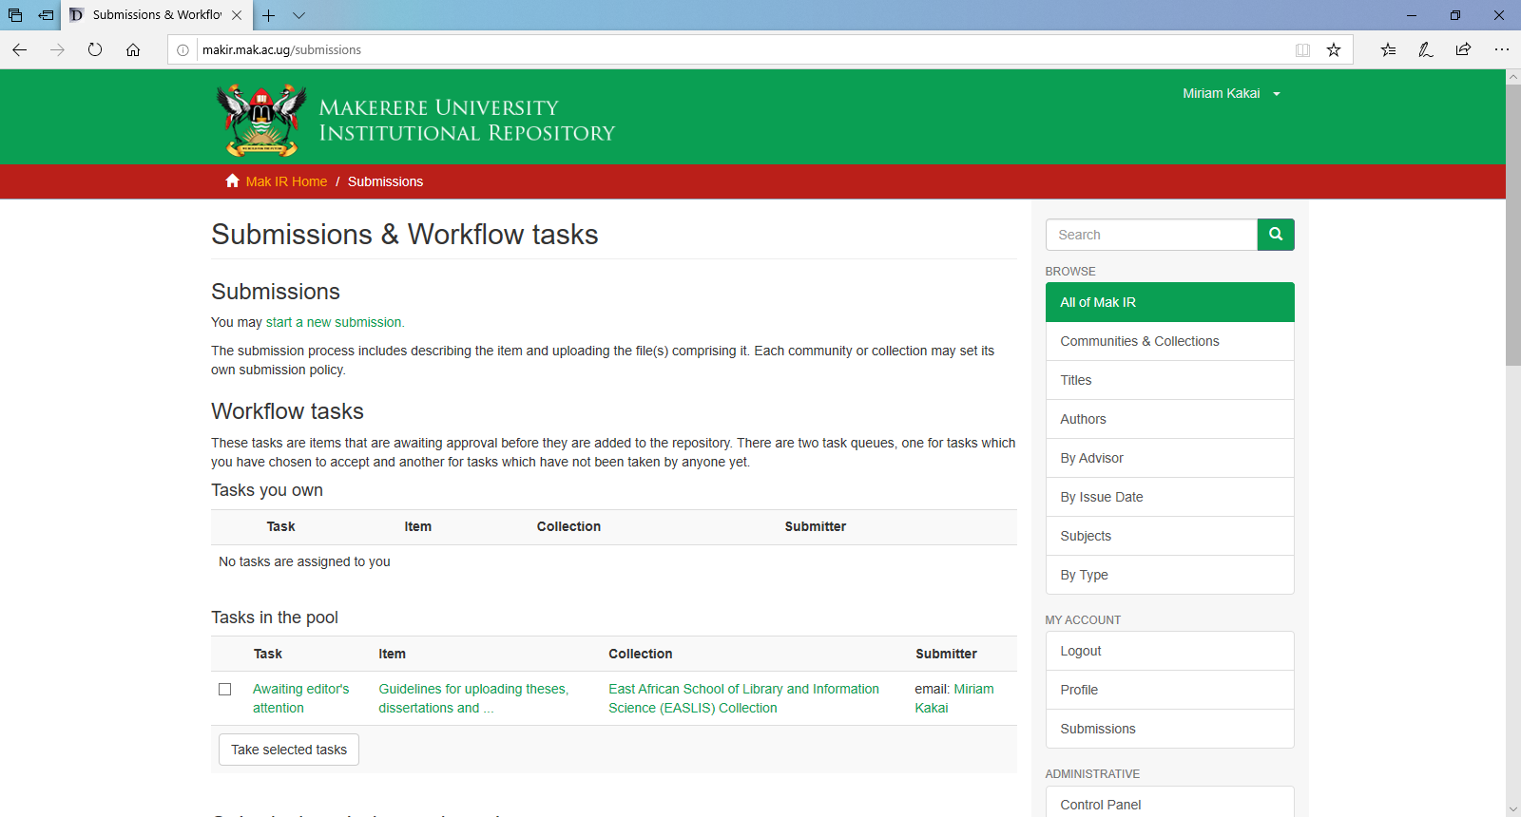
Your submission is awaiting an editor’s attention.
Once there are no issues that need your attention, your submission will be approved, and an auto-email notification sent to the submitter.

Slide 20
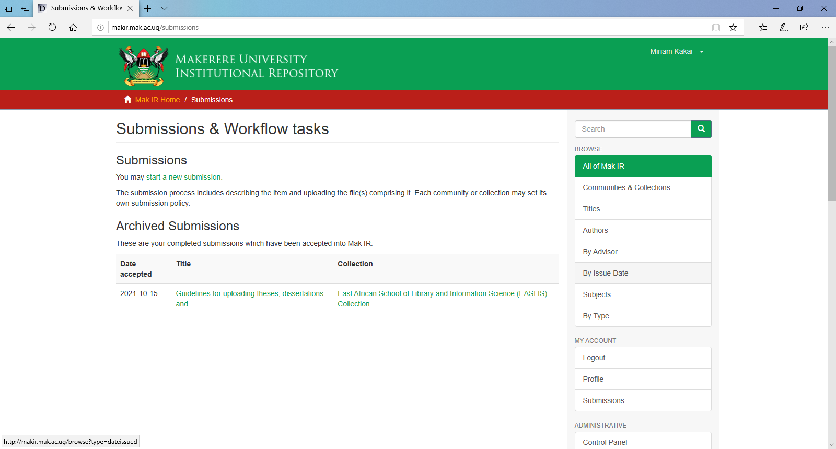
After receiving the auto-email notification,
Login and click the submissions link to check the status of your submission, which should appear under Archived Submissions.

Slide 21
Contact Information:
Digitisation Section,
3rd Floor, New Library Extension,
Makerere University Main Library,
Email: makir.mulib@mak.ac.ug

